Slide 1

Study on Characteristics Influencing Airbnb Rental Popularity in Shanghai
Group Members:
Ruitian Wu (rw219@duke.edu)
Sissi Wang(xw187@duke.edu)
Yuzhe Gu (yg172@duke.edu)

Slide 2

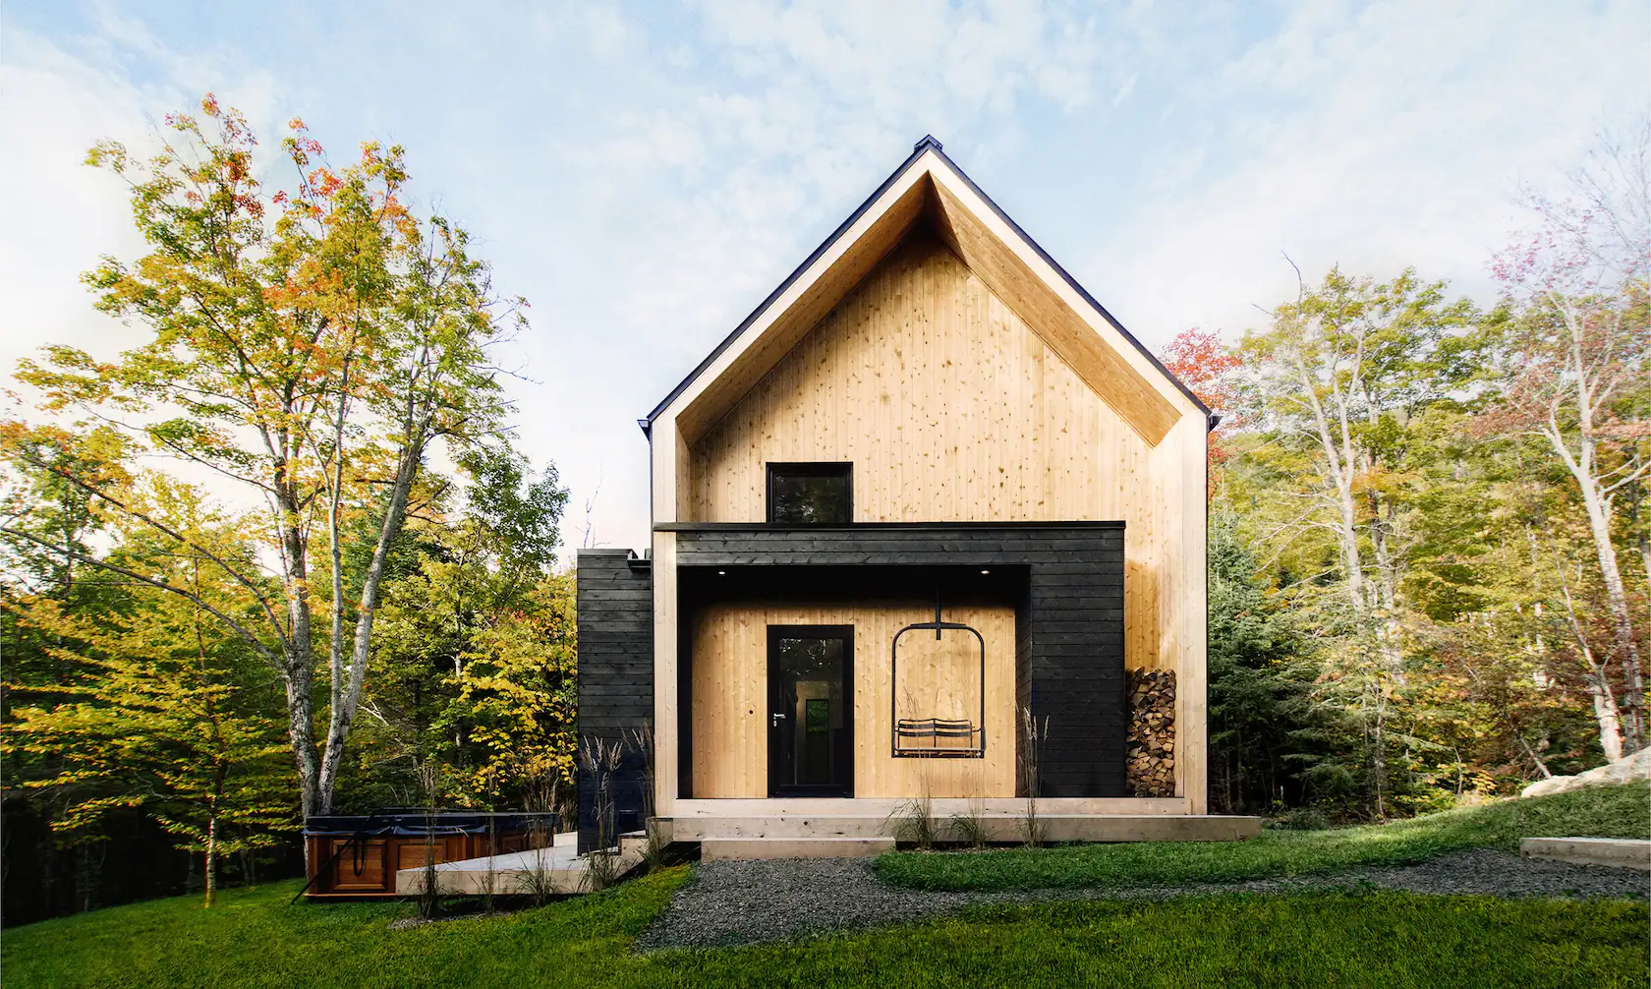
Roadmap
Introduction
Method
Data Collection
Data Cleaning
Analysis and Visualization
Result
5 sub-question
Discussion
5 sub-question
Conclusion

Slide 3
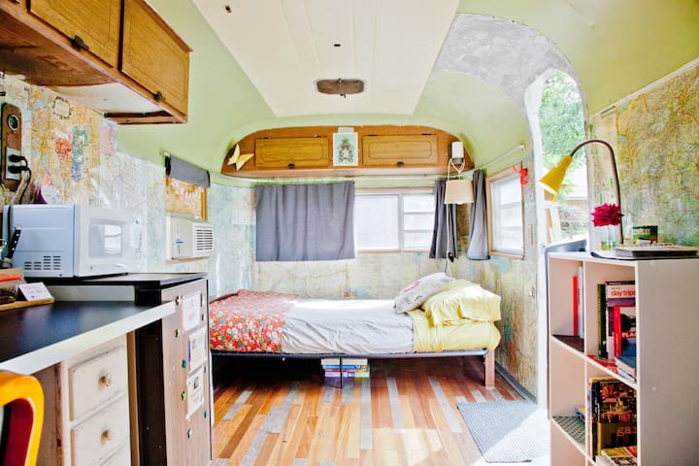


Introduction
Main question:
What factors could influence popularity of the homestays
Data:
Airbnb in Shanghai
Airbnb: a website for the marketing of lodges

Slide 4
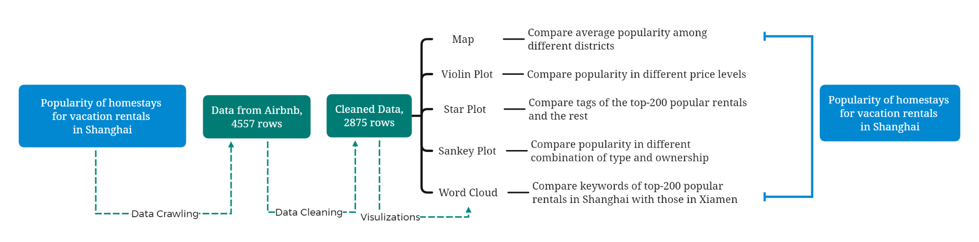
Introduction
Mindmap:

Slide 5
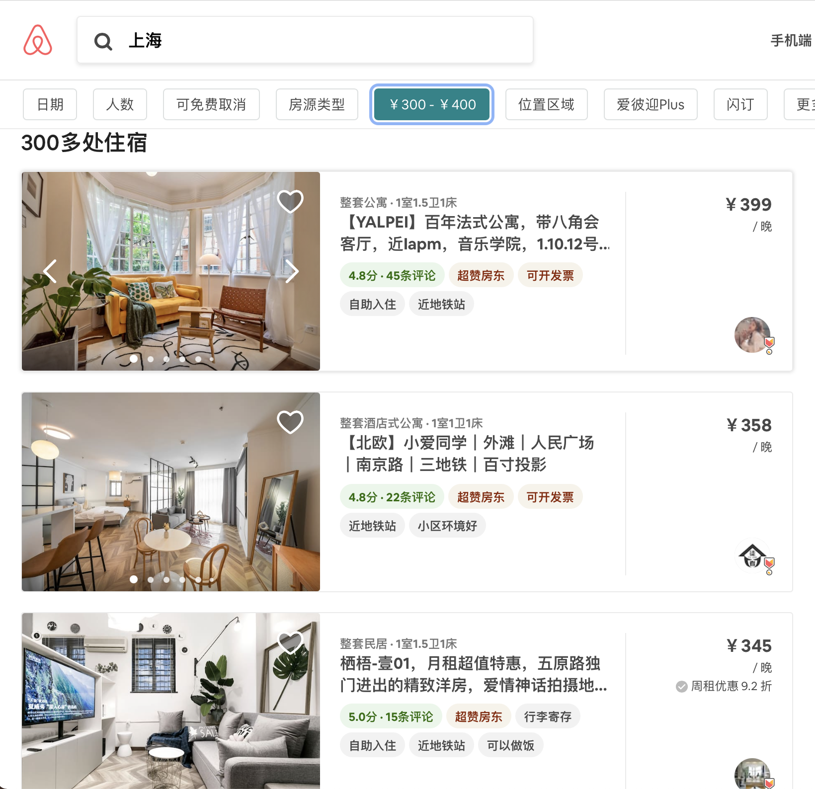
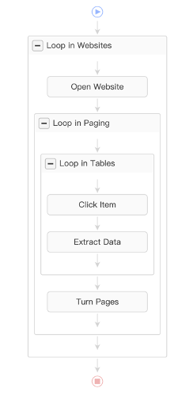
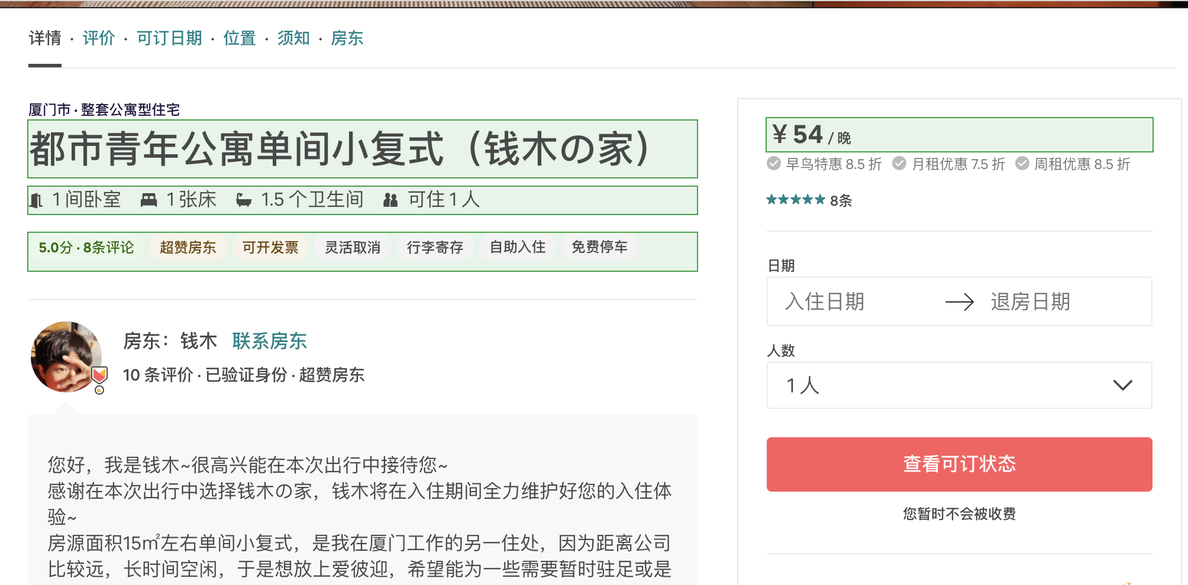
Method_Data collection

Slide 6
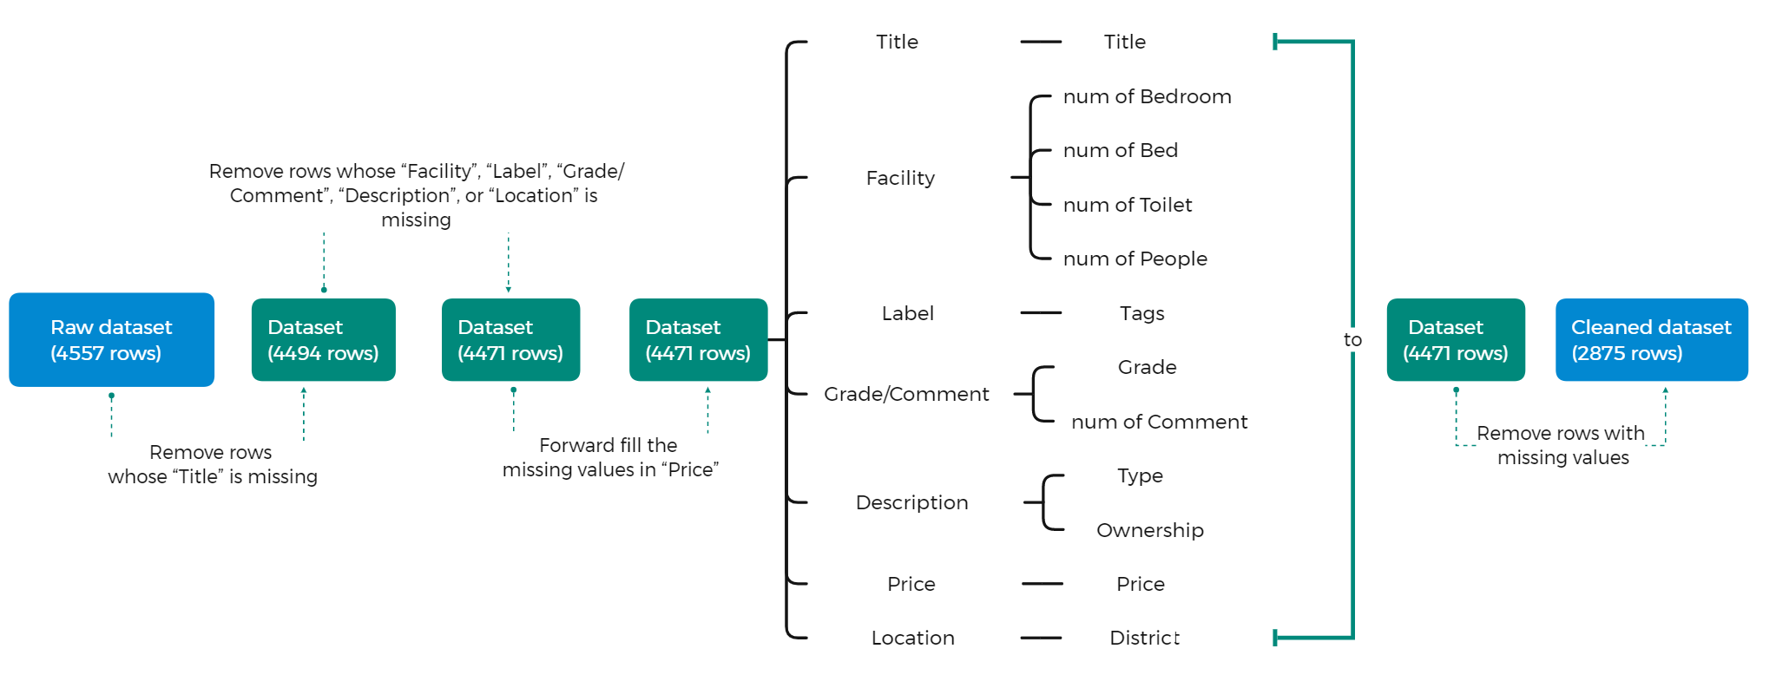
Method_Data cleaning

Slide 7
Method_Data cleaning
For example,
before cleaning:
after cleaning:

Slide 8
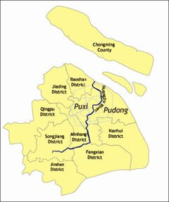
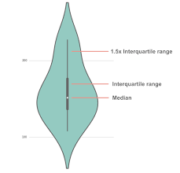
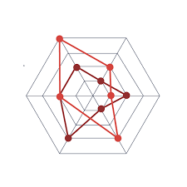
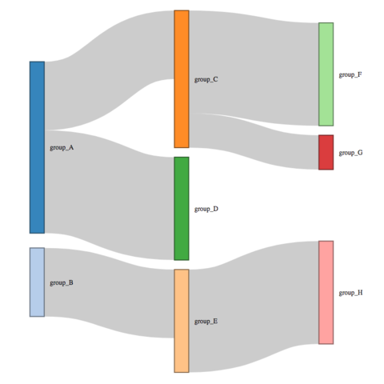

Method_Analysis and visualize
Current Popularity
num_of_
comments
log
multiply
Popularity
Popularity Index
Future Popularity
grades
Geographical Location
District
Map
Influence
House Price
Price Level
Violin Plot
Characteristics
Services
Tags
Star Plot
House Type
Type & Ownership
Sankey Diagram
Keywords
Title
Word Cloud

Slide 9
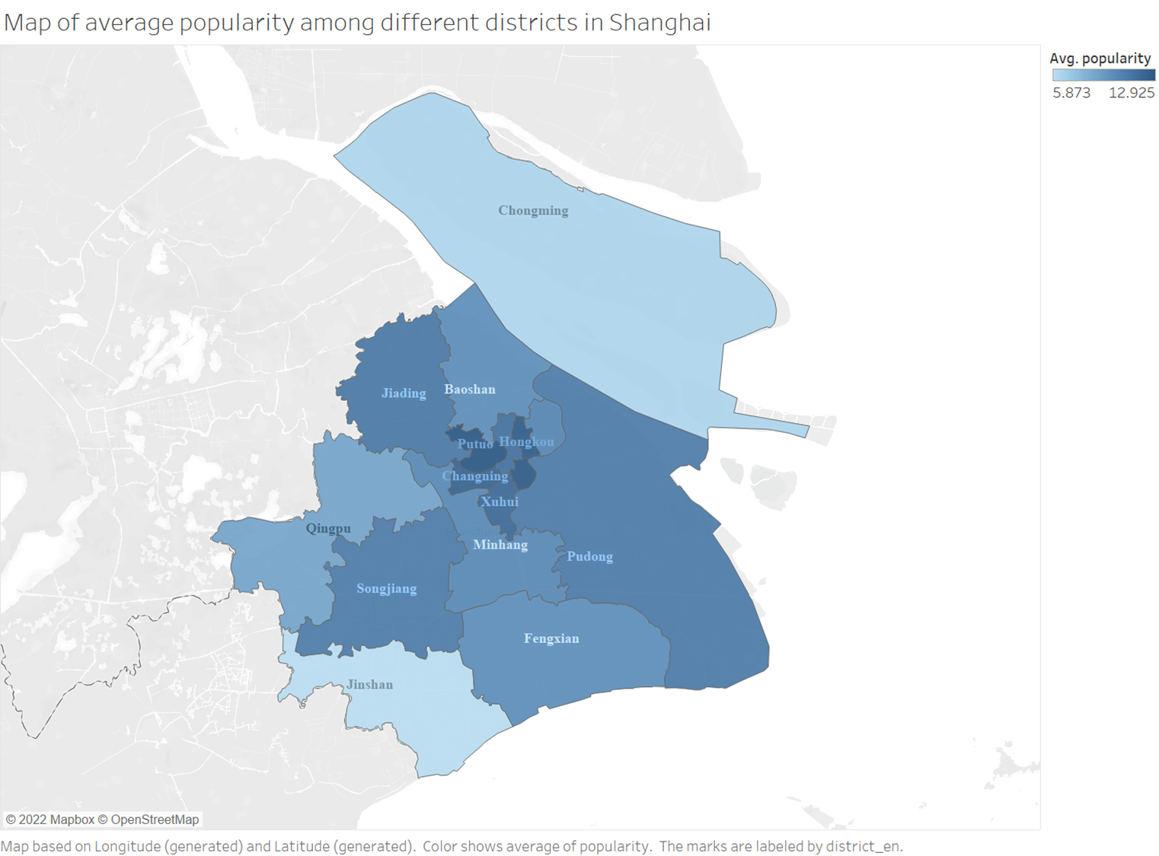
Result_Map
Goal:
Compare average popularity of rentals among different districts in Shanghai
Channel:
Position,
Color(luminance)

Slide 10
Result_Map
Findings:
Most popular:
Putuo, Huangpu, and Hongkou
Less popular:
Chongming and Jinshan
Rentals in the center of Shanghai are more popular than rentals in remote areas.

Slide 11
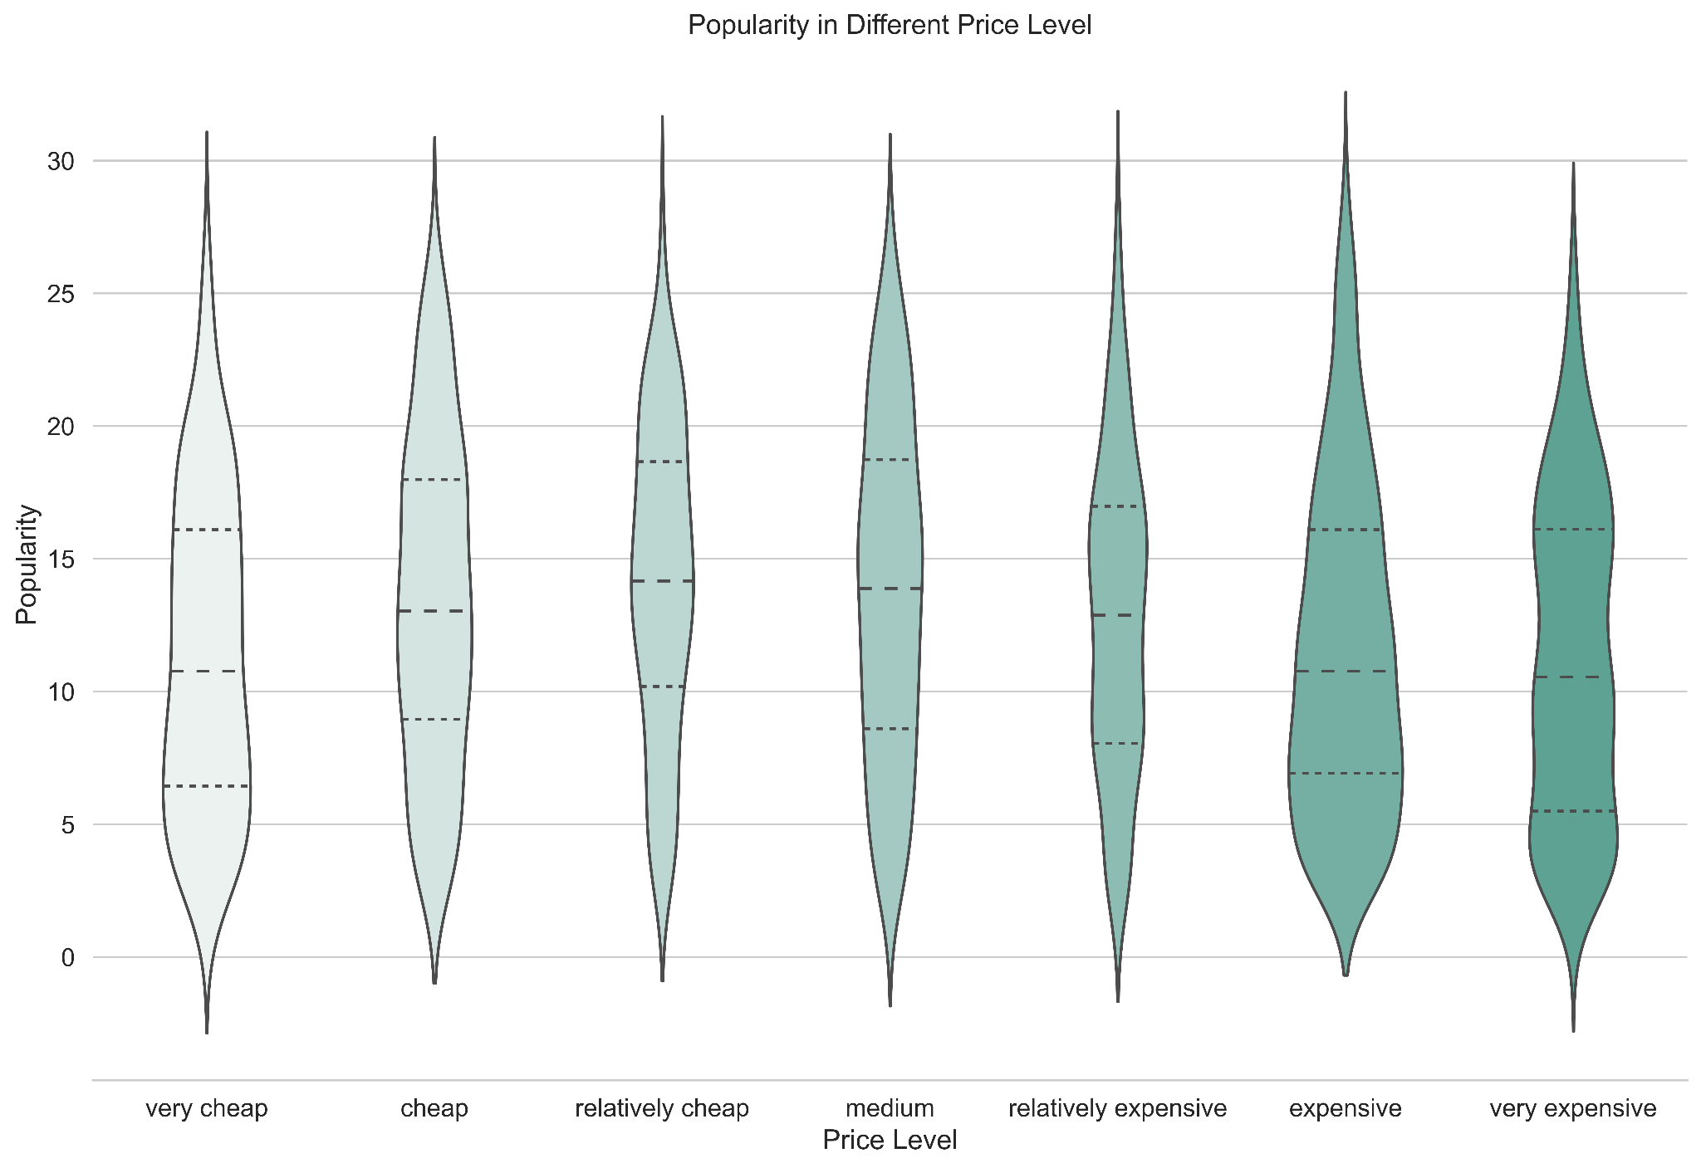
Result_Violin Plot
Goal:
Portait distribution of popularity in different price levels and find the level with the highest popularity
Channel:
Position,
Color(luminance)
Size

Slide 12
Result_Map
Findings:
Generally most popular:
Relatively cheap & Medium
Extremely popular:
Expensive
generally medium price rentals are most popular. As price increases or decreases, popularity decreases.
“Social-media influencer” culture cause some expensive rentals extremely popular.
Q3
Median
Q1

Slide 13
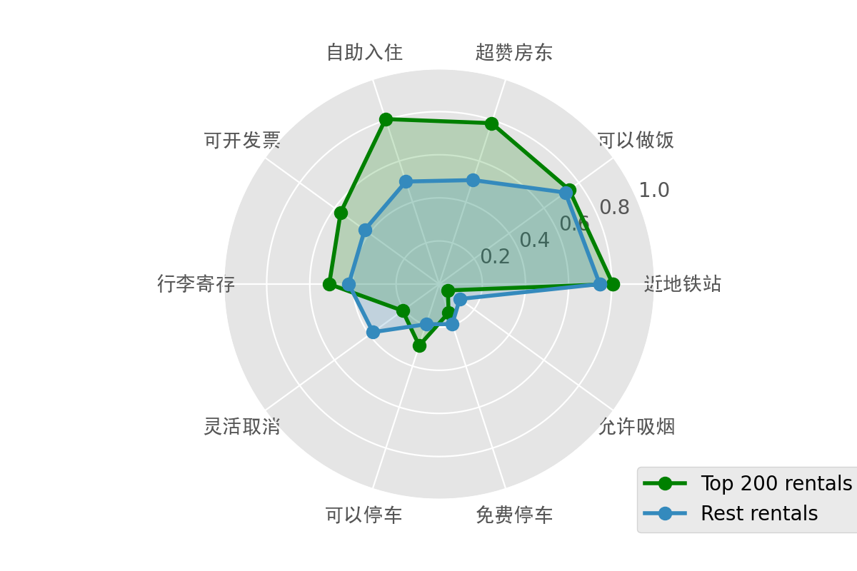
Result_Star Plot
Goal:
Compare the commonly observed tags of the top 200 rentals with highest popularity and those of the rest
Channel:
Position,
Color(Hue)

Slide 14
Result_Star Plot
Findings:
Top 200 rentals have higher percentage of:
自主入住 (check-in by yourself)
超赞房东 (brilliant landlord)
可开发票(has invoice)
lower percentage of:
灵活取消(free to cancel)
Convenience, friendliness, and invoice;
Stricter condition to cancel

Slide 15
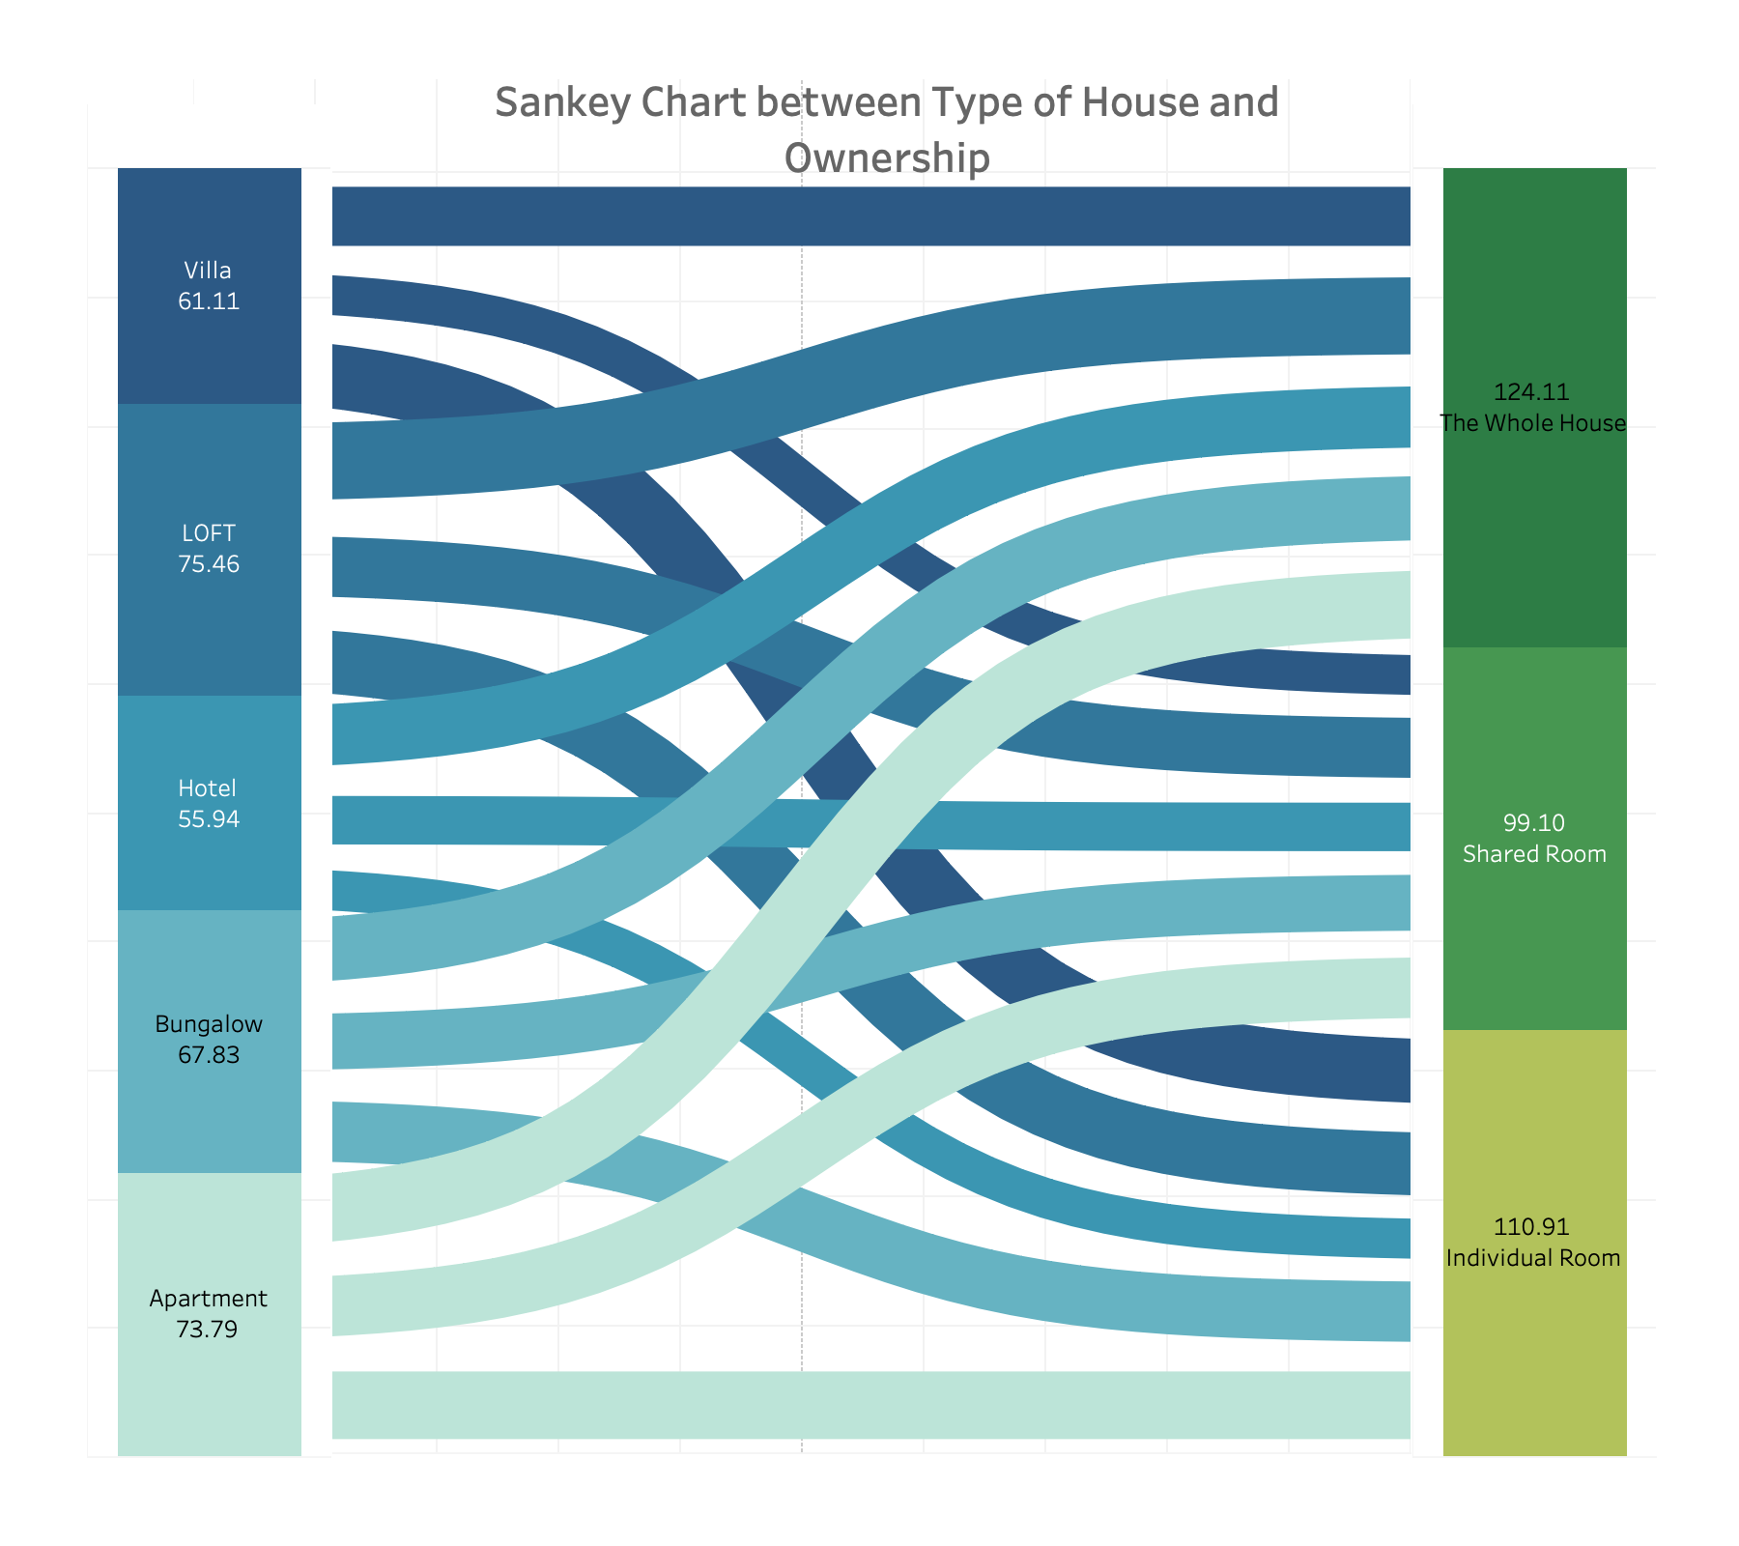
Result_Sankey Plot
Goal:
Find what combination of house type and ownership is most popular
Channel:
Color(hue, luminance),
Width

Slide 16
Result_Star Plot
Widest
Findings:
Most Popular Type:
LOFT
Most Popular Ownership:
The Whole House
Most Popular Combination:
The Whole LOFT
Popular in terms of privacy, convenience and aesthetics;
Suitable for enjoying city life and taking photos

Slide 17
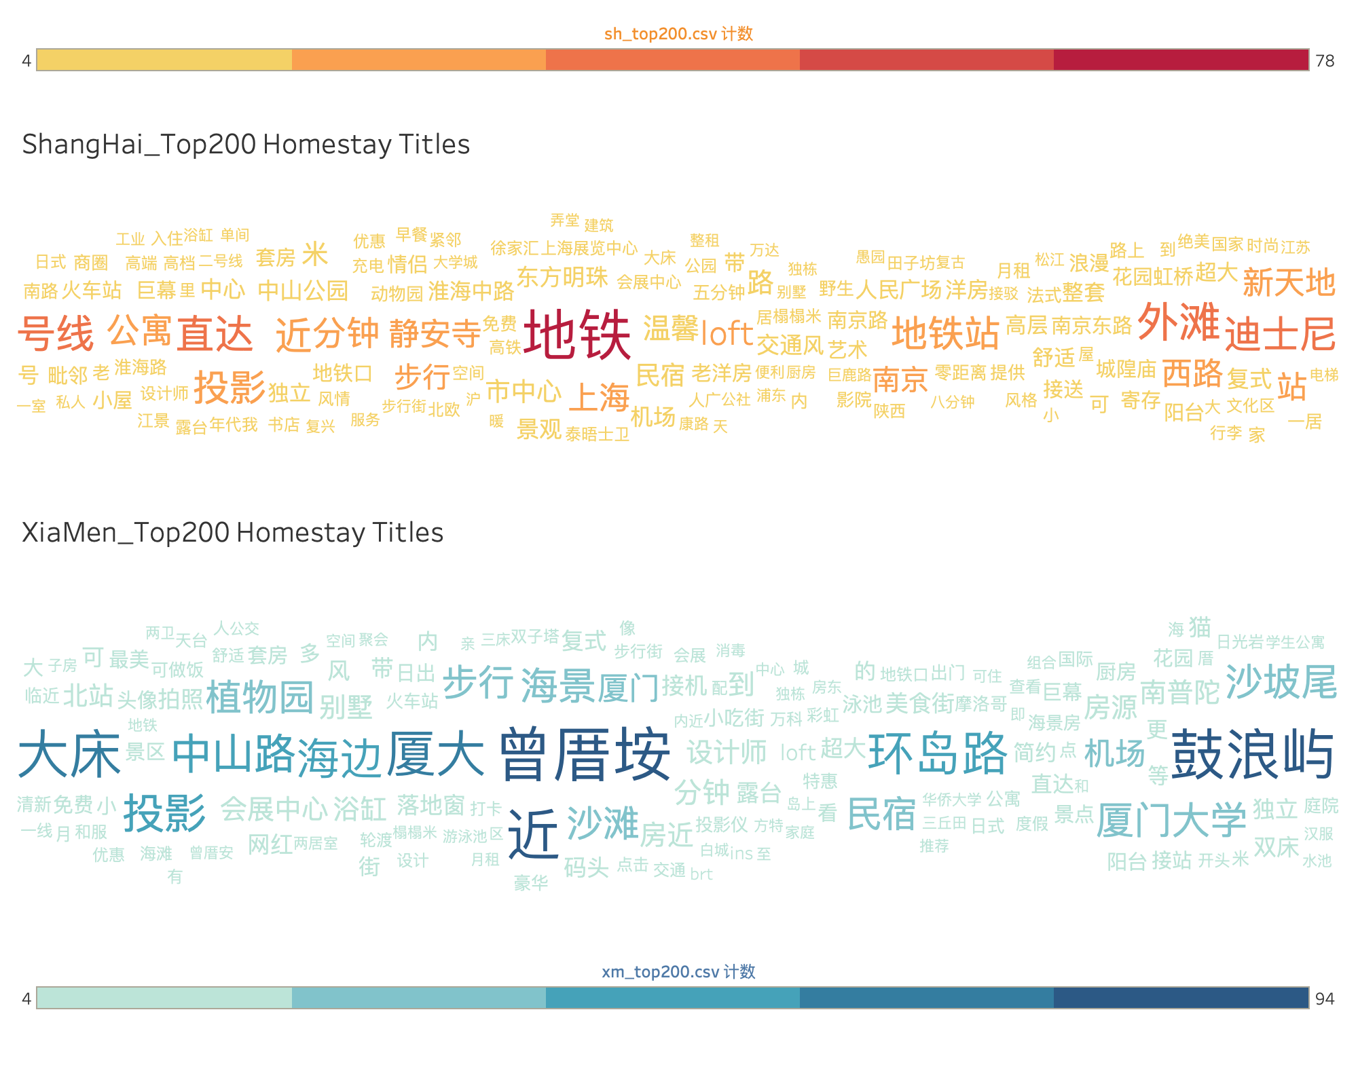
Result_Word Cloud
Goal:
Discover hot keywords in popular homestay titles; Compare hot keywords in shanghai & xiamen
Channel:
Position,
Font Hue, Saturation, Size

Slide 18
Result_Word Cloud
Findings:
Contain scenic spots
Suggest convenience
“Metro” in SH
“Sea” in XM
Reflect different local cultures

Slide 19
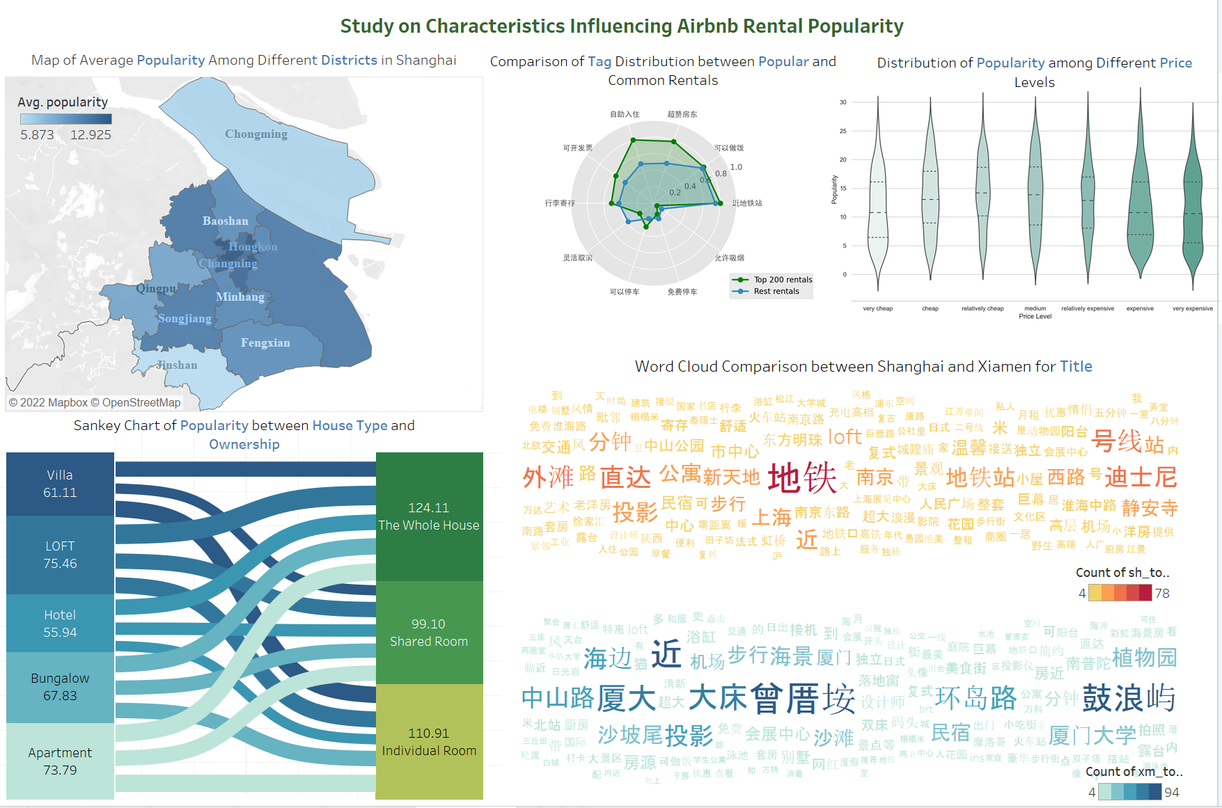
Result_Dashboard

Slide 20
Discussion_Map
User task:
retrieve value of average popularity
correlate popularity with location
Efficiency: 👍
position and color：clear to distinguish
label of names

Slide 21
Discussion_Violin Plot
User task:
determine range of popularity
compute derived value like median
characterize popularity distribution
correlate popularity with price
Efficiency:👍
Violin Plot: suitable idiom for comparing groups
luminance and position: easy to tell difference

Slide 22
Discussion_Star Plot
User task:
retrieve value of frequency of labels
correlate popularity with labels.
find extreme of frequency
Efficiency: 👍
two dimensions of comparisons

Slide 23
Discussion_Sankey Plot
User task:
retrieve value of popularity for each category
find extreme of popularity
correate popularity with two attributes
Efficiency:👍
Sankey Diagram: show patterns in different combinations
Clear distinctions in width and illuustrative label

Slide 24
Discussion_Word Cloud
User Task:
compute derived value of keyword frequency
sort the keywords
correlate popularity with hot words in the title
Efficiency:👍
Word Cloud: Highlight most hot words
Quick Interpretation

Slide 25
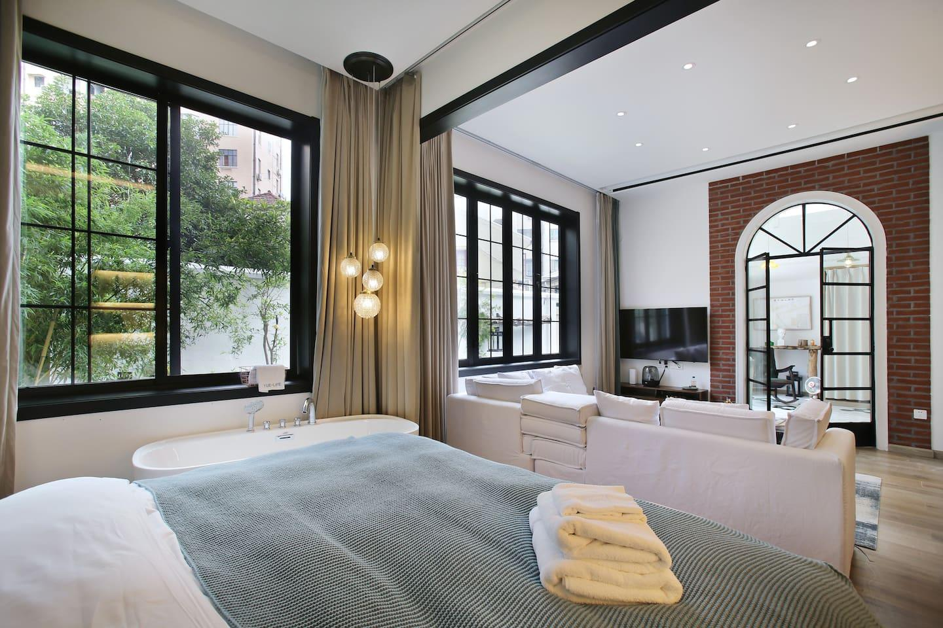
Conclusion
Popular Homestays
Downtown Location
Moderate Prices
People-Oriented Service
Convenient Transport&Nearby business Areas
High-end Houses (LOFT)

Slide 26
Reference
[1] Randy Kerber. 1992. ChiMerge: discretization of numeric attributes. In Proceedings of the tenth national conference on Artificial intelligence (AAAI’ 92). AAAI Press, 123-128

Slide 27
Q & A

Slide 28
Thank you!

